Slide 1

Introduction to Programming
A Comprehensive Overview of Languages, Compilers, and Architectures
Venkata Bhattaram

Slide 2
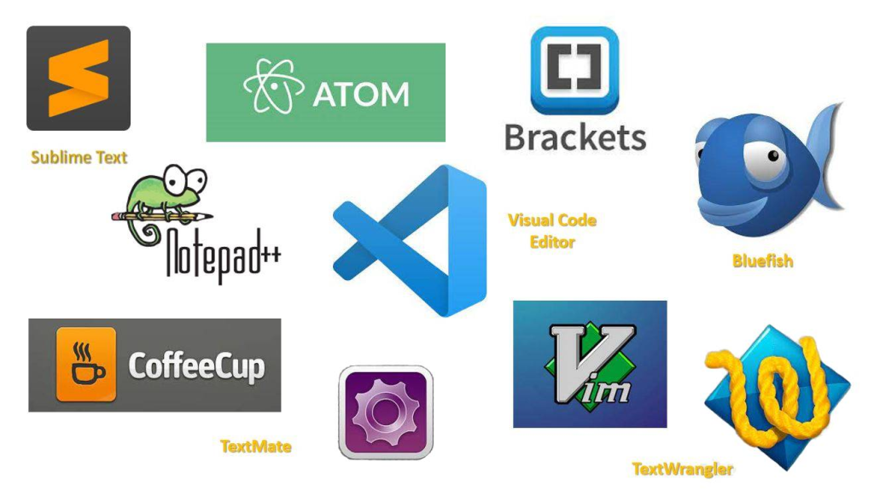
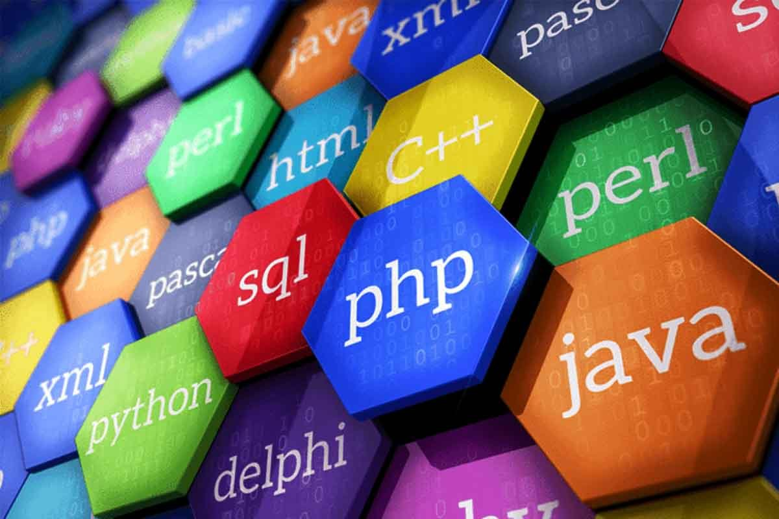
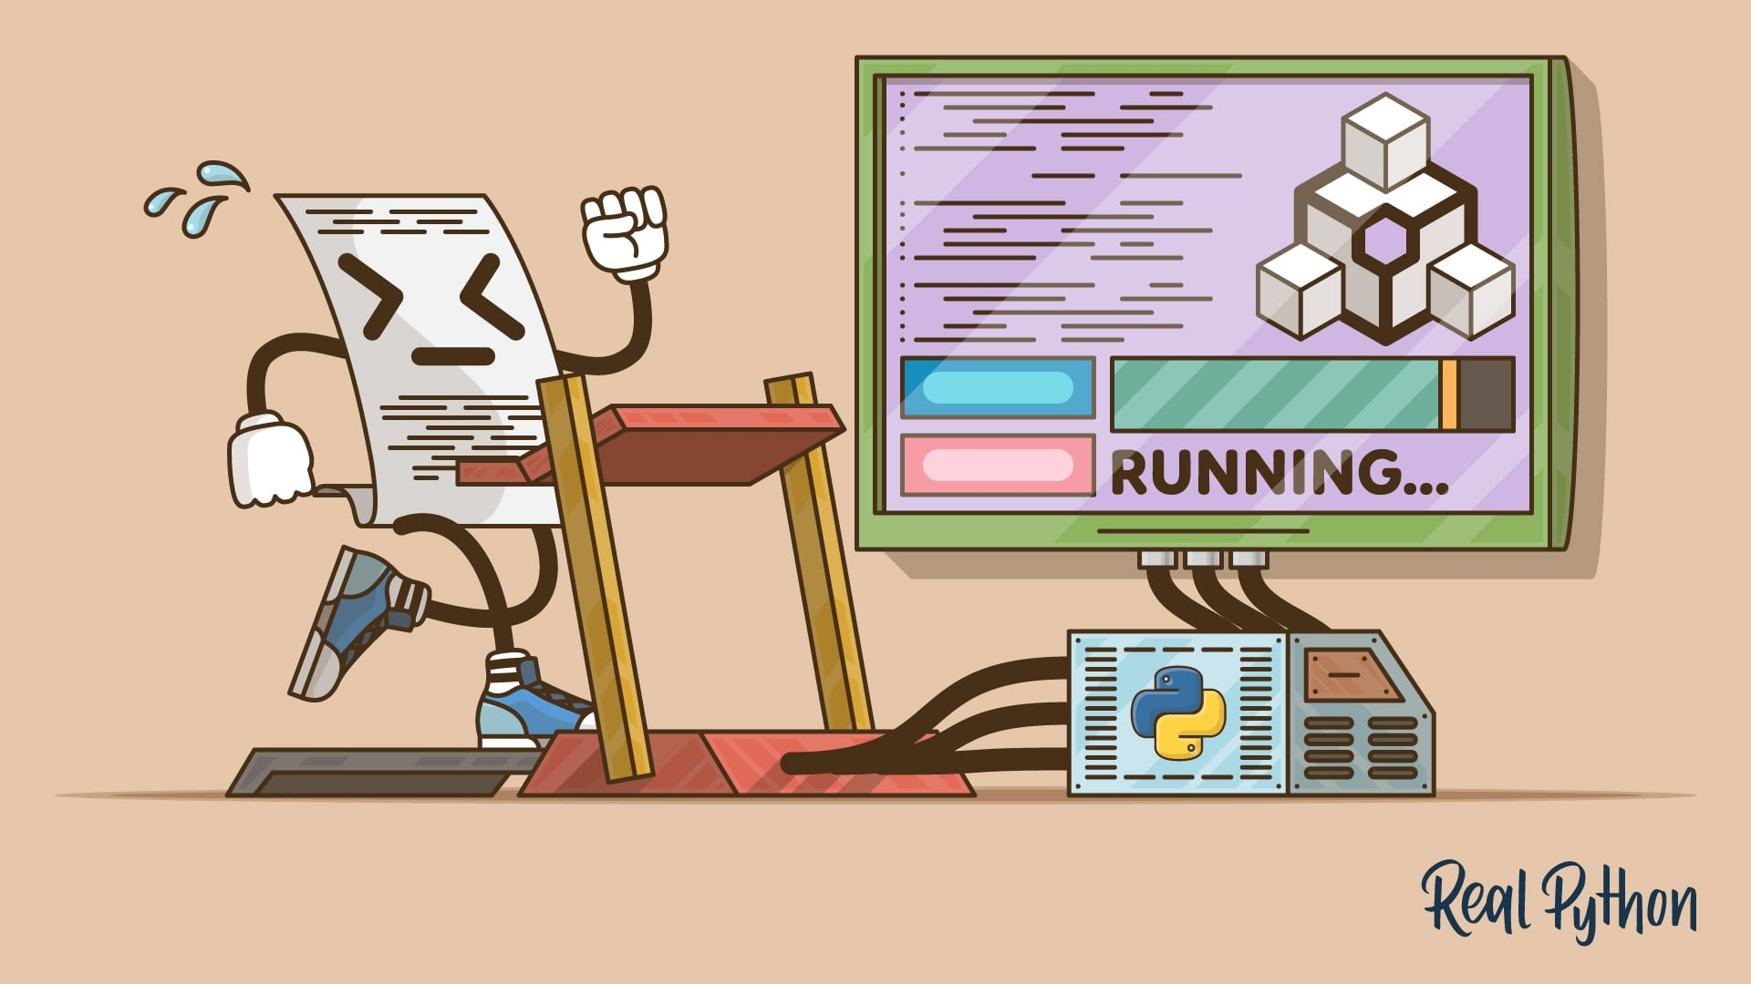
Compilers & Code
Programming is the process of providing instructions to a computer. A crucial part of this process involves compilers—specialized programs that translate human-readable source code into machine code or bytecode that a computer processor can execute.

Slide 3
Compiled Languages: 2-Step Process
Compiler
Runner
Translates human-readable code into an intermediate format.
The runtime environment executes the final code on the machine.
Source Code
Bytecode
Text file written in a compiled language (e.g., C, C++, Java, C#).
Intermediate machine-level instructions generated by the compiler.

Slide 4






Scripting Languages: Execution Flow
1. Source Code
2. Compiler/Runner
3. Execution
Written in Python, JavaScript, TypeScript, or PHP. No explicit pre-compilation step is required by the developer.
The application is executed immediately by the runtime environment without producing a separate bytecode file.
The language engine interprets or Just-In-Time (JIT) compiles the code dynamically on the fly.

Slide 5
The Learning Path
From fundamental syntax to advanced software engineering concepts.

Slide 6


Foundational Concepts
Basics & Data Structures
Object-Oriented Programming
•
Language Basics: Understand variables, data types, loops, and conditional logic.
•
Classes & Objects: Blueprinting real-world entities into reusable code modules.
•
Data Organization: Master arrays, lists, dictionaries, and sets.
•
Inheritance: Sharing attributes and methods across hierarchical class structures.
•
Complex Structures: Learn trees, graphs, and memory management basics.
•
Polymorphism & Encapsulation: Ensuring flexibility and securing data states within objects.

Slide 7
Essential Libraries
System & Utilities: Mastering Date/Time functions and executing native OS Commands for robust automation.
File Handling: Reading, writing, and securely manipulating local file systems efficiently.
Database Handling: Connecting to and querying SQL and NoSQL databases for persistent application storage.
Data Formats: Parsing, serializing, and generating standard industry formats including CSV, JSON, XML, and Parquet.

Slide 8

Advanced Programming Features
Decorators: Dynamically alter the functionality of functions or classes through metaprogramming.
RegEx: Leverage powerful pattern matching for complex text searching and validation.
MultiThreading: Utilize concurrent execution to optimize and scale I/O-bound tasks.
MultiProcessing: Implement parallel execution to maximize CPU utilization across cores.
Pickle: Perform object serialization for saving and loading complex data states.

Slide 9

Mastering the Craft
Programming is a continuous journey of learning, optimizing, and building the future.

Slide 10
Questions?
Thank you for your time and attention.

